Slide 1
CIP - Customer Intelligence Platform
12th October 2021

Slide 2


Brute force data loss mitigation
Business use case
Technical description
Problem description: Storing records of access to customer’s account credential stuffing is one of the most usual cyberattack Entain is exposed to. Last year we closed an investigation with the GRA due to a breach notification based on a credential stuffing attack we suffered in Gala and Ladbrokes brands. As part of the measures, we took the information Security team implemented a process to review credential stuffing attacks monthly however, we would like to implement additional actions to ensure the system includes all the guarantees the safety of our customers’ data in the event of credential stuffing attack. The project would include the implementation of the following measures; 1.- Implement a log system to be capable to identify if attackers have accessed customer account information.
Label(s) impacted: All labels
Action taken:
Consuming the pageview events when player visits My account section in the site, store this data in Elasticsearch,Hdfs and create visualizations to view this data.
Business benefit: we can identify If attackers access the customer account information.
Design: CIP consumes pageview(session_id,account_id,ip_address,datetime_my_account_accessed) events from frontend through GTM,persist this data in elasticsearch,HDFS and create visualizations through Kibana, Hue.
Notes:
Four key points

Slide 3







Architecture Diagram
GTM Server
User Device (PC/Laptop/Tablet/ Mobile/PDA)
Snowplow FrontEnd (SPF)
Analytics Kafka
Snowplow Processor (SPP)
DATA Upload Service (DUS)
Elasticsearch(LGS)
Notes:
Four key points

Slide 4
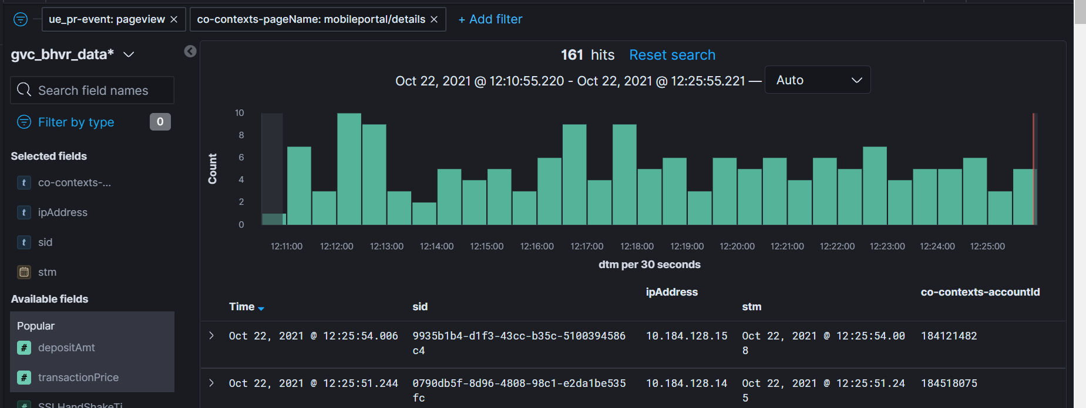
Kibana
Kibana Url: http://localhost:5601/app/kibana#/discover/af5e0800-25e0-11ec-bb1b-717b33e7f18c?_g=(filters:!(),refreshInterval:(pause:!t,value:0),time:(from:now-15m,to:now))&_a=(columns:!(sid,ipAddress,stm,co-contexts-accountId),filters:!(('$state':(store:appState),meta:(alias:!n,disabled:!f,index:'91ad4c90-8211-11ea-9f2a-0d725d5fa3a7',key:ue_pr-event,negate:!f,params:(query:pageview),type:phrase),query:(match_phrase:(ue_pr-event:pageview))),('$state':(store:appState),meta:(alias:!n,disabled:!f,index:'91ad4c90-8211-11ea-9f2a-0d725d5fa3a7',key:co-contexts-pageName,negate:!f,params:(query:mobileportal%2Fdetails),type:phrase),query:(match_phrase:(co-contexts-pageName:mobileportal%2Fdetails)))),index:'91ad4c90-8211-11ea-9f2a-0d725d5fa3a7',interval:auto,query:(language:kuery,query:''),sort:!())

